Slide 1
DNS Team
IETF 99 Hackathon

Slide 2
Participants (new to IETF & hackathon)
Stéphane Bortzmeyer
Tariq Damra
Sara Dickinson
John Dickinson
Ralph Dolmans
Jim Hague
Paul Hoffman
Shuman Huque
Shane Kerr
Matti Klock
Dave Lawrence
Benno Overeinder
Melinda Shore
Petr Špaček
Ondřej Surý
Willem Toorop
Jan Včelák
Lars Wegmann

Slide 3
Education

Slide 4
Work on Drafts and Standards
New Ed25519 elliptic curve support in Knot Resolver [RFC 8032]
DNS multiple QTYPEs prototype implementation in BIND [draft-bellis-dnsext-multi-qtypes]
TCP Fast Open in Knot Resolver [RFC 7413]
DNSSEC chain TLS extension in getdns and Unbound [draft-ietf-tls-dnssec-chain-extension]
Work on the C-DNS capture format [draft-ietf-dnsop-dns-capture-format]

Slide 5
Root KSK Roll-over (October 11th, 2017)
DNS testing tool Deckard
Extending test set for Automated Updates for DNSSEC Trust Anchors [RFC 5011]
support for Knot Resolver
support for Unbound
Root KSK roll-over timeline
July 11th: publication of new KSK
October 11th: new KSK is used to sign the root zone
January 11th: revocation of old KSK

Slide 6
Since DANE, DNSSEC not just for
DNS Operators

Slide 7
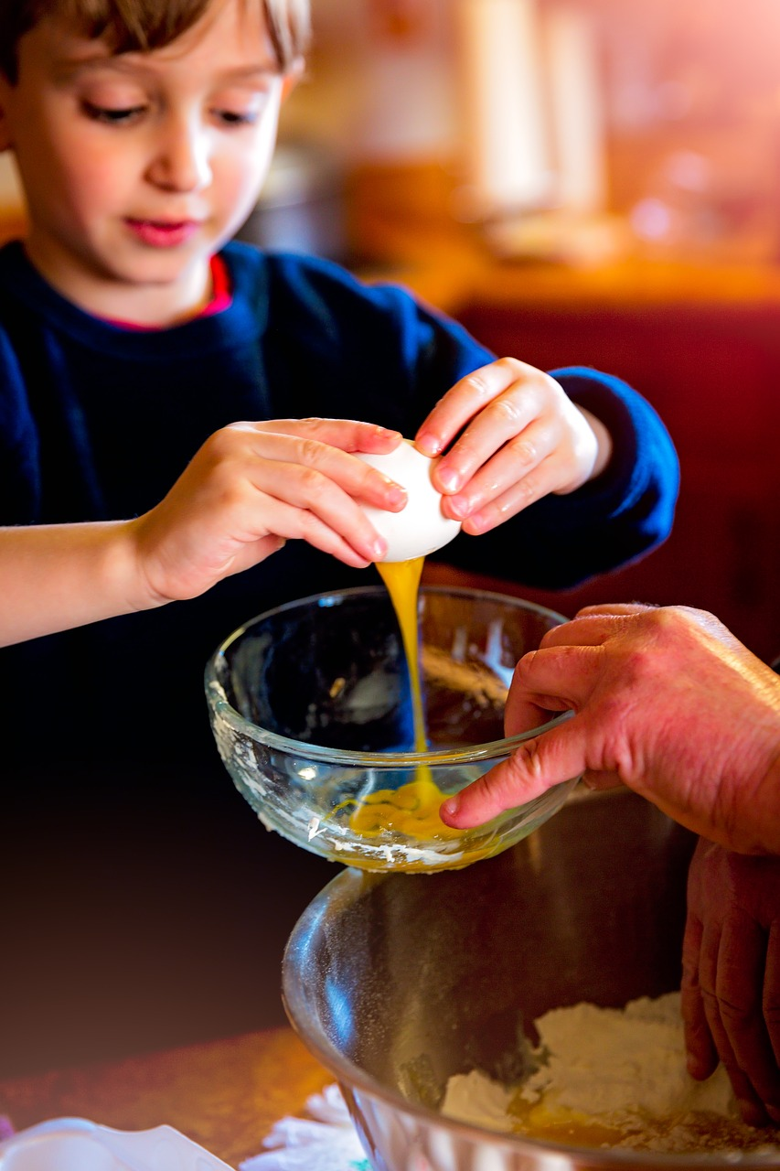
Since DANE, DNSSEC not just for
but also
for end-users
DNS Operators

Slide 8
Since DANE, DNSSEC not just for
but also
for end-users
Network Working Group M. StJohns
Request for Comments: 5011 Independent
Category: Standards Track September 2007
Automated Updates of DNS Security (DNSSEC) Trust Anchors
Status of This Memo
This document specifies an Internet standards track protocol for the
Internet community, and requests discussion and suggestions for
improvements. Please refer to the current edition of the "Internet
Official Protocol Standards" (STD 1) for the standardization state
and status of this protocol. Distribution of this memo is unlimited.
Abstract
This document describes a means for automated, authenticated, and
authorized updating of DNSSEC "trust anchors". The method provides
protection against N-1 key compromises of N keys in the trust point
key set. Based on the trust established by the presence of a current
anchor, other anchors may be added at the same place in the
hierarchy, and, ultimately, supplant the existing anchor(s).
DNS Operators

Slide 9
Hack: Zero configuration DNSSEC for end-user applications
delivers DNSSEC to home cooks (i.e. end-user apps)
Anticipate not running as a stable process
Anticipate other “malicious” end-user apps How?
download TA from ICANN on the fly when needed
Minimize # downloads, by:
Storing DNSKEY too
Retry download only on newly seen Key IDs

Slide 10
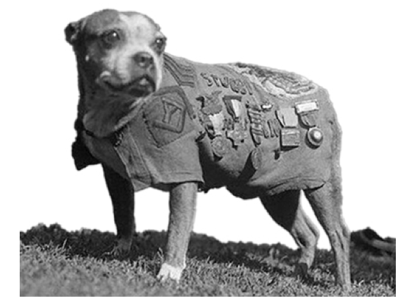
Research & Innovation (No Standards!)
Experimentation with Opportunistic TTL refresh of DNS records
Stubby packaging, GUI development and documentation.

